Slide 1

FE-545

Slide 2
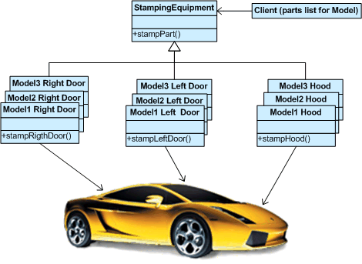
The Factory
FE-545
Lecture 12
Ricardo A. Collado Assistant Professor School of Business

Slide 3
Introduction
We wish to design an interface that the user will input the name of a pay-off and a strike, and the program will then price a vanilla option with that pay-off
This needs a conversion routine from strings and strikes to pay-offs
Simple solution: a function that takes in the string and the strike, checks against all known types of pay-offs and creates a pay-off of the right type
Easily implemented via a switch statement
Would need to include the header files for all possible forms of pay-off
Every time a new pay-off is added it requires modifying the switch statement
This violates the open-closed principle as any addition involves modification
A proper solution would allow us to add new pay-offs without changing any of the existing files by simply adding new files
For this we use a design pattern known as the factory pattern

Slide 4
The Factory Pattern

Slide 5
Intent
“Provide an interface for creating families of related or dependent objects without specifying their concrete classes.”
provide a simple creational interface for a complex family of classes
Client does not have to know any of those details
avoid naming concrete classes
Clients use abstract creational interfaces and abstract product interfaces. Concrete classes can be changed without affecting clients.

Slide 6
Applicability
Use the Abstract Factory Pattern if:
clients need to be ignorant of how servers are created, composed, and represented.
clients need to operate with one of several families of products
a family of products must be used together, not mixed with products of other families
provide a library and want to show just the interface, not implementation of the library components.

Slide 7
Collaborators
Usually only one ConcreteFactory instance is used for an activation, matched to a specific application context. It builds a specific product family for client use -- the client doesn’t care which family is used -- it simply needs the services appropriate for the current context.
The client may use the AbstractFactory interface to initiate creation, or some other agent may use the AbstractFactory on the client’s behalf.
The factory returns, to its clients, specific product instances bound to the product interface. This is what clients use for all access to the instances.

Slide 8
Consequences
The Abstract Factory Pattern has the following benefits:
It isolates concrete classes from the client.
You use the Abstract Factory to control the classes of objects the client creates.
Product names are isolated in the implementation of the Concrete Factory, clients use the instances through their abstract interfaces.
Exchanging defined product families is easy.
None of the client code breaks because the abstract interfaces don’t change.
Because the abstract factory creates a complete family of products, the whole product family changes when the concrete factory is changed.
It promotes consistency among products.
It is the concrete factory’s job to make sure that the right products are used together.
It is also easy to replace any implementation of the product interfaces. Just rebuild the library and copy into the client’s directory.

Slide 9
Abstract Interface

Slide 10
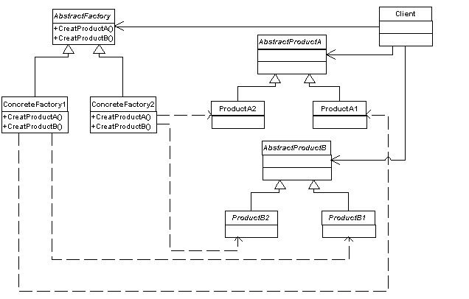
Abstract Factory Structure

Slide 11
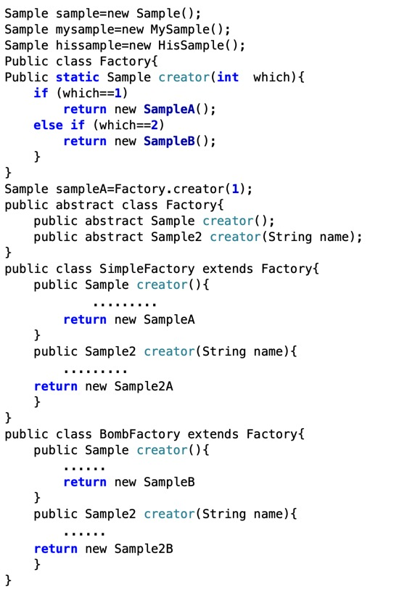
Implementation example:

Slide 12
Application to Options Pricing

Slide 13
The Factory
Our solution requires each type of pay-off to tell the factory that it exists, and to give the factory a blueprint for its manufacture
We get the class to communicate with the factory, without explicitly calling anything from the main routine by using global variables
Every global variable is initialized when the program commences before anything else happens
We define a class such that initializing a global variable of that class registers a pay-off class with the factory via its constructor.
For each pay-off class, we write an auxiliary class whose constructor registers the pay-off class with our factory, and we declare a global variable of the auxiliary class.
As these auxiliary classes will all be very similar to each other, we adopt a template solution for defining these classes.

Slide 14
The Factory
We need a factory object for these auxiliary classes to talk to.
This cannot be a global variable, since we have no control over the order in which global variables are initialized.
The factory object needs to exist before the other global variables are defined as they refer to it
There is a type of variable guaranteed to come into existence at the moment it is first referred to: the static variable.
A static variable defined in a function persists from one call to the next, and only disappears when the program exits.
All the registration function calls will register the pay-off blueprints with the same factory.
The creator function needs to have access to the same factory object as the registration function, and if the factory is hidden inside the registration function this will not be possible.
The solution to this problem is the singleton pattern.

Slide 15
The Singleton Pattern
The singleton pattern is a way to define a class such that:
An object of the class exists as soon as it is required, and for this exists until the end of the program.
Only one object of the class can exists.
To achieve this in the singleton pattern all constructors and assignment operators are made private.
Therefore factories can only be created from inside methods of the class, giving us control over the existence of factory objects.
To obtain exactly one class object create a method that defines a class object as a static variable.
For example, if our class is called PayOffFactory, define a class method Instance as follows:
PayOffFactory& PayOffFactory::Instance() {
static PayOffFactory theFactory;
return theFactory; }
The first time that Instance is called, it creates the static data member theFactory using the private default constructor.
Every subsequent time the Instance is called, the address of the already-existing static variable theFactory is returned.
Thus Instance creates precisely one PayOffFactory object which can be accessed by calling PayOffFactory::Instance()
Note: Instance will have to be a static method of PayOffFactory, as the whole point is that it provides you with a PayOffFactory object, and it would be useless if you had to access it from an existing object.
Note: the meaning of static here for a function is different from the meaning for a variable;
For a function static means that the function can be called directly without any attachment to an object.
One still has to prefix with the name of class, however.

Slide 16
Coding the Factory
Upon registration, we need to know the string identifier for the specific pay-off class and the pointer to the function which creates the object in question.
These will be arguments for the registration method.
The factory needs to store this information for when the create pay-off method is called.
This requires a container class
We use the STL container map class which is designed for associating identifiers to objects.
We also need a method which turns a string plus a strike into a PayOff object

Slide 17
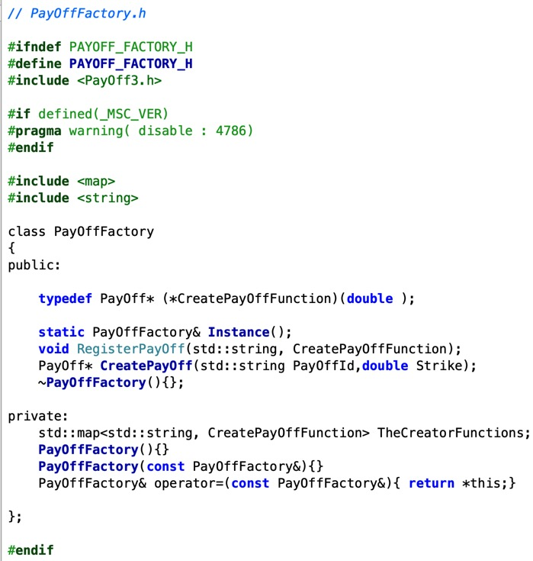
Note: the typedef allow us to refer to pointers to functions which take in a double and return a PayOff* as CreatePayOffFunction
Note: CreatePayOff method returns a pointer to a PayOff. The reason for this is that it allows the possibility of returning a null pointer if the identity string was not found; otherwise we would have to throw an error or return a default sort of pay-off.

Slide 18
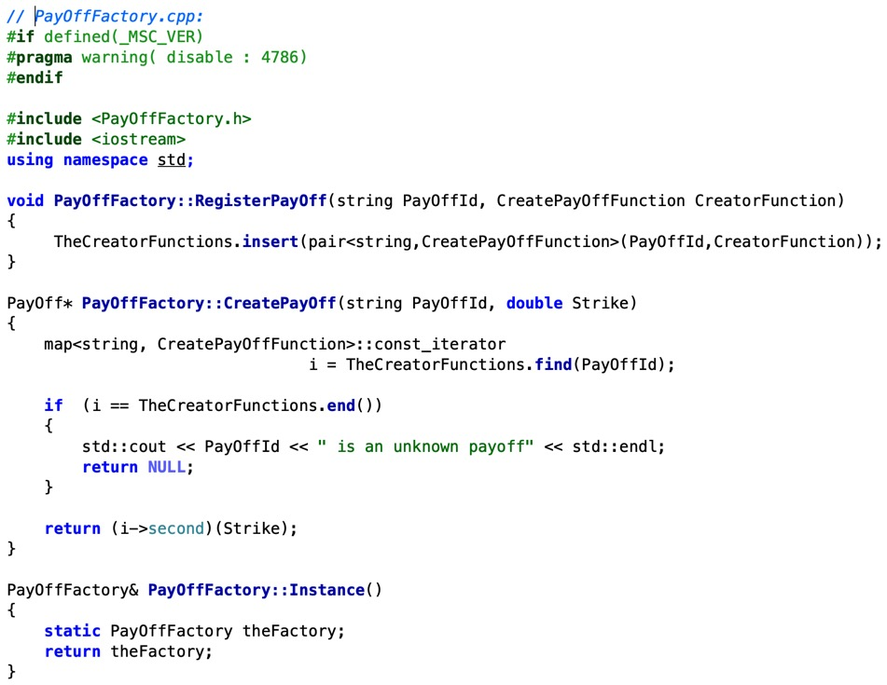
Note: the retrieval is carried out in CreatePayOff: a string is passed in and the find method of map is used. This method returns a const iterator pointing to the pair which has the correct key (i.e. first element) if such a pair exists, and otherwise the iterator points to the end of the map.
Note: A map has the property that each key is unique so if we insert two pairs with the same key then the second one is ignored. This means that if we give two PayOff classes the same string identifier only one will be registered.
Note: We examine the return type of the insert to determine whether the insertion was successful. The method RegisterPayOff carries out this insertion for our factory.
Note: an iterator is an abstraction of a pointer and works in similar fashion. Just like pointers, they can be dereferenced via * or ->. A const iterator is similar to a non-const pointer to const objects. That is, the iterator’s value can be changed, but the value of the thing it points to cannot.

Slide 19
Automatic Registration
We perform registration of PayOff classes by using global variables.
The code is the same except for class names for each registration so we use a template class.
The helper class has to do two things.
It must define a constructor that carries out the registration of the class defined by the template parameters
It must define a function to carry out the creation so we have something to use in the registration process.
Constructor:
Takes in a string as an argument.
First calls Instance to get the address of the factory object, and then calls the RegisterPayOff method of the factory to carry out the registration.
The constructor does not actually do anything as regards the actual object being created. In fact, the class has no data members so it would not be possible to do anything.

Slide 20
Automatic Registration
The method Create:
Defines the function used to create the pay-off object on demand.
It is static as it should not be associated to any particular class object.
The function calls the constructor for objects of type T with argument Strike.
The template parameter, T, is making the choice of which object to construct.
Note that we use new as we want the created object to persist after the function is finished.
One consequence of this is that the object will have to be properly deleted at some point.

Slide 21
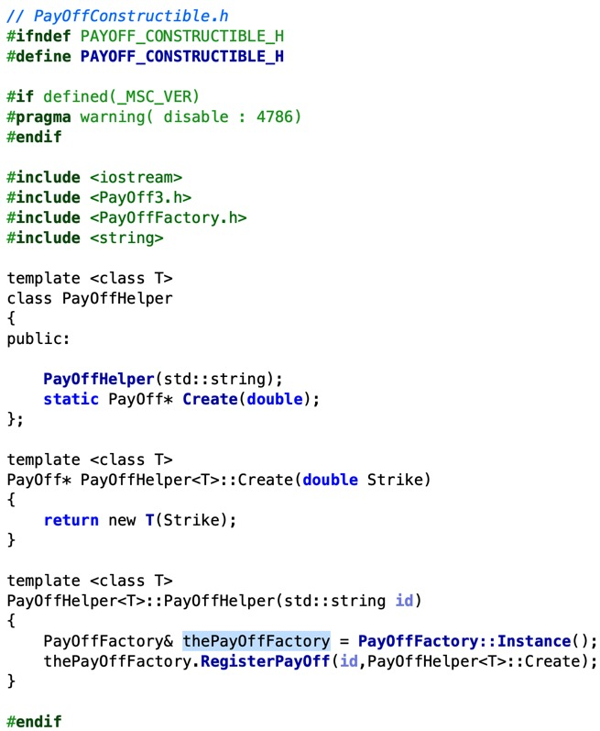

Slide 22
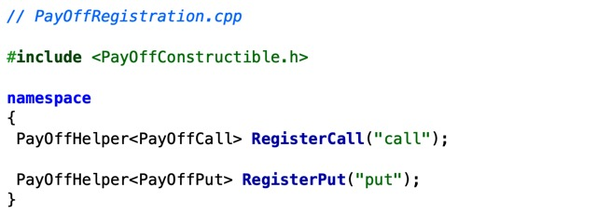
Automatic Registration
The namespace command around the declaration means that the variables are in an unnamed namespace and as such are invisible to the rest of the program.
So the variables are both global and invisible.
Their purpose is to perform the registration
Once registration has been done we have no further use for them so it is best to put them out of reach.
If we were defining a new class, we would probably put this registration in the source file for the class but as we have already defined the call and put classes, we do not do so here.
The registration defines two global variables, RegisterCall and RegisterPut. These are of type PayOffHelper<Call> and PayOffHelper<Put>.
As global variables, they are initialized at the start of the program. This initialization carries out the registration as required.

Slide 23
Using the Factory
The user inputs spot, strike and the name of the option.
If an option with that name has been registered then the pay-off is computed, and the object is then deleted.
Name definitions are carried out in the file PayOffRegistration.cpp, and this file is not seen directly by any of the other files including the main routine.
If we want to add another PayOff, say the forward, we could do so without modifying any of the existing files.
All we would have to do is add the header and source file for the forward, and in a new file PayOffForwardRegistration.cpp add the declaration:
PayOffHelper<PayOffForward> RegisterForward("forward");
As desired, this would not require recompilation of any of the original files.
We have therefore achieved our original objective of an open-closed pattern.

Slide 24
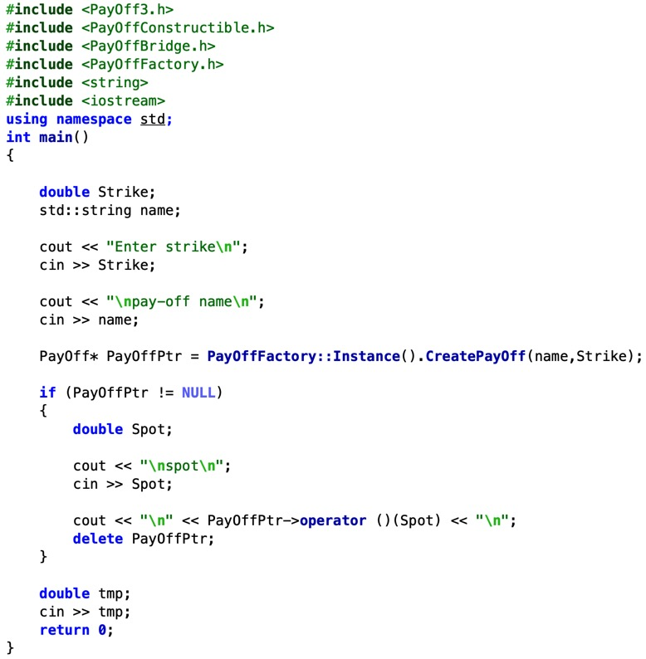

Slide 25
Ricardo A. Collado
rcollado@stevens.edu
(201) 216-8156

